Slide 1
STORING DATA:
DISKS & FILES
A memory is what is left when something happens and does not completely unhappen.
|Edward DeBono

Slide 2
Table of content
Memory in the computer system.
Disk arrays.
The disk space manager.
The buffer manager.
Files.
Indexes.

Slide 3
Memory in the computer system

Slide 4
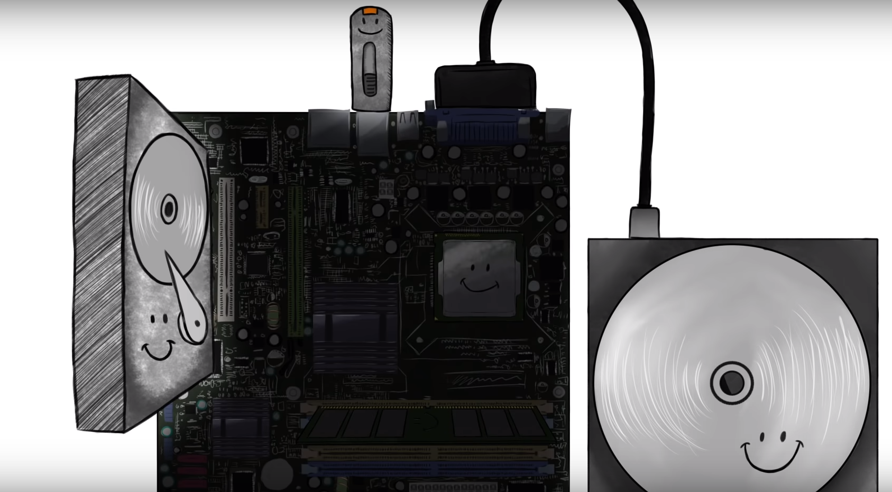
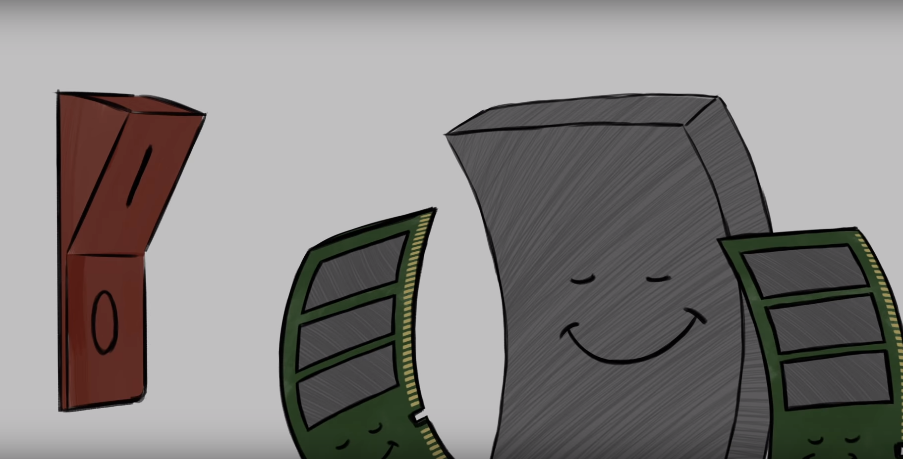
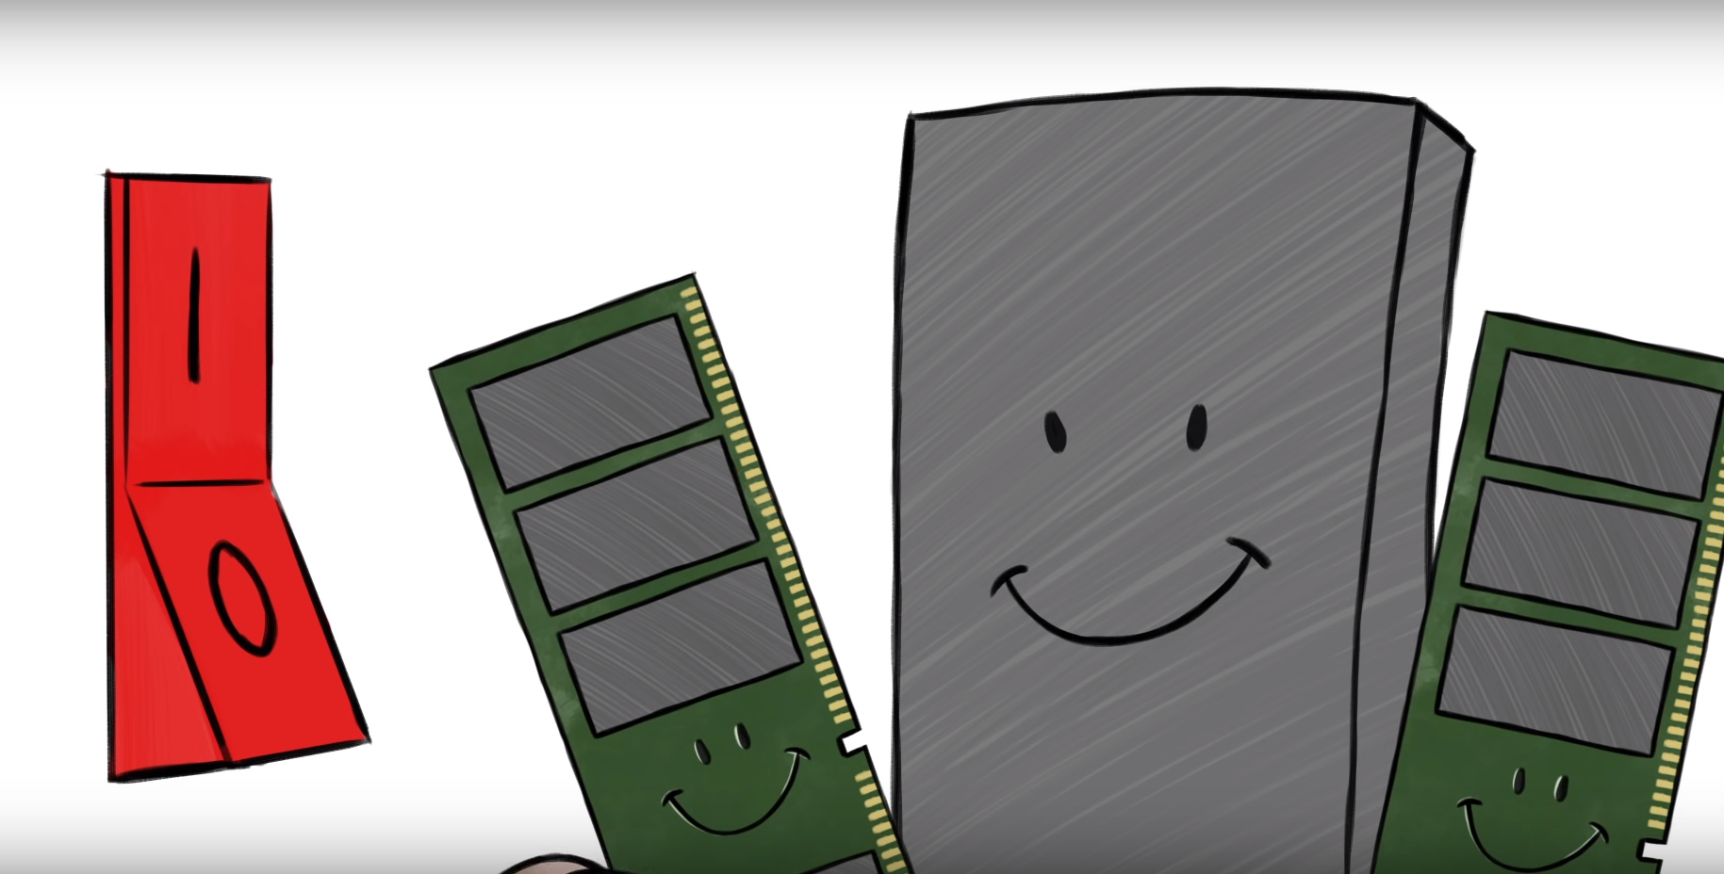
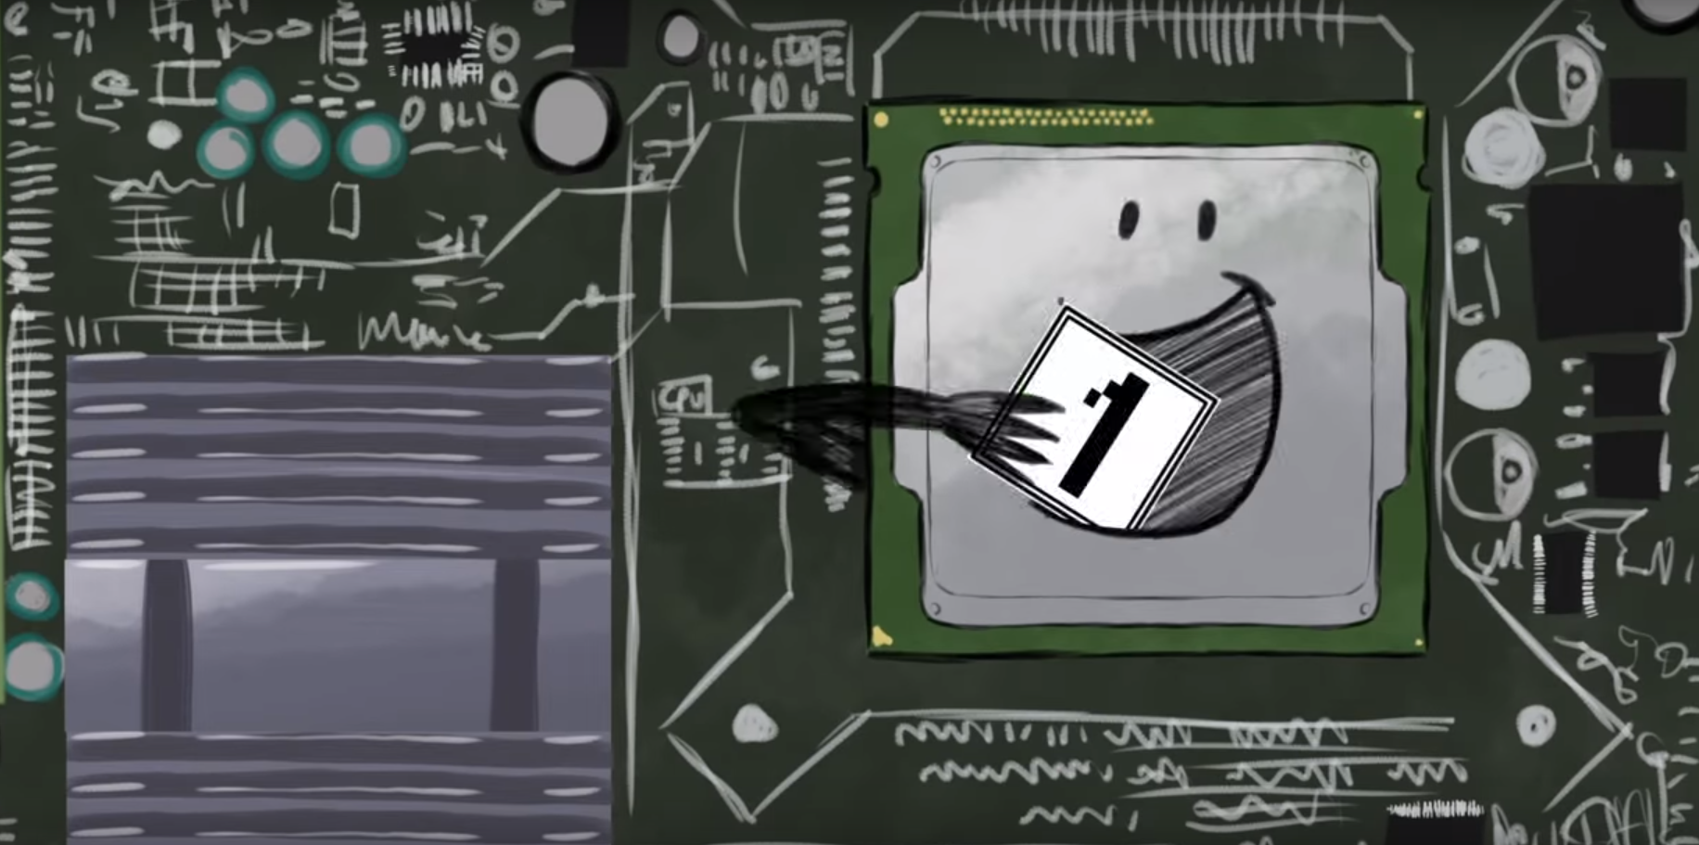


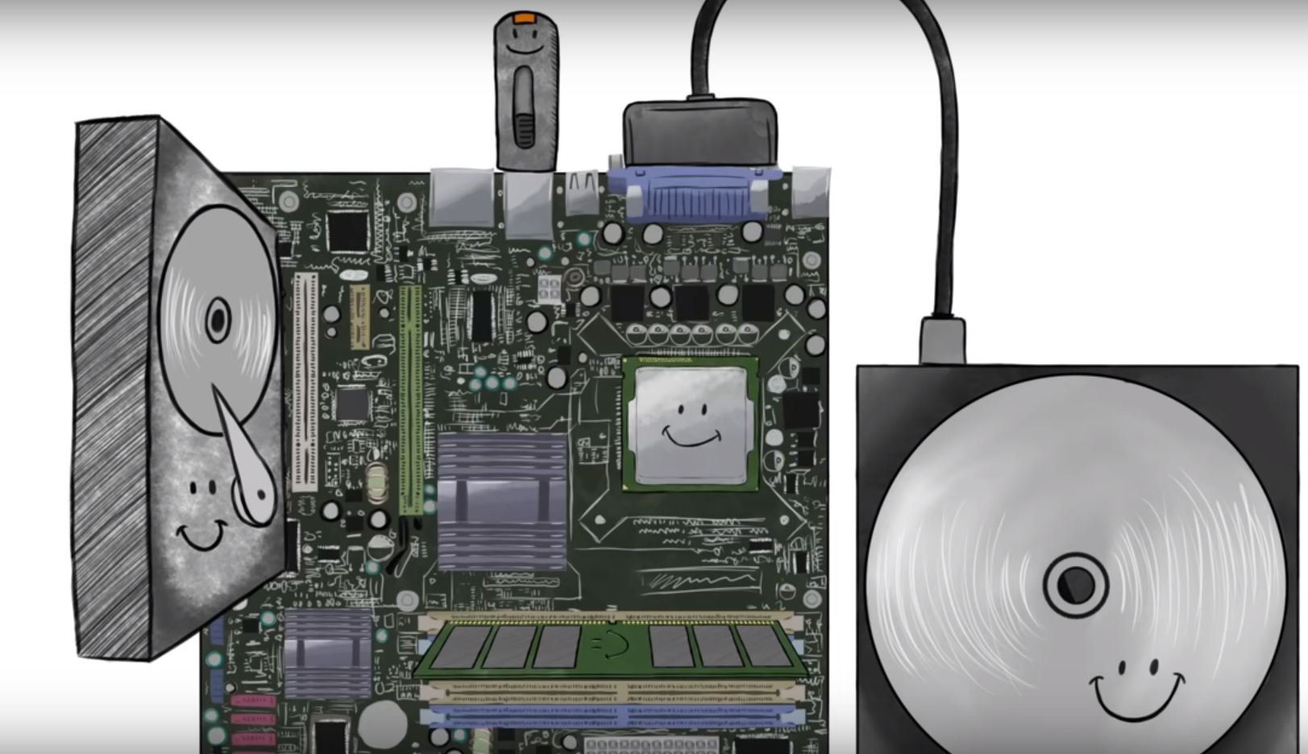
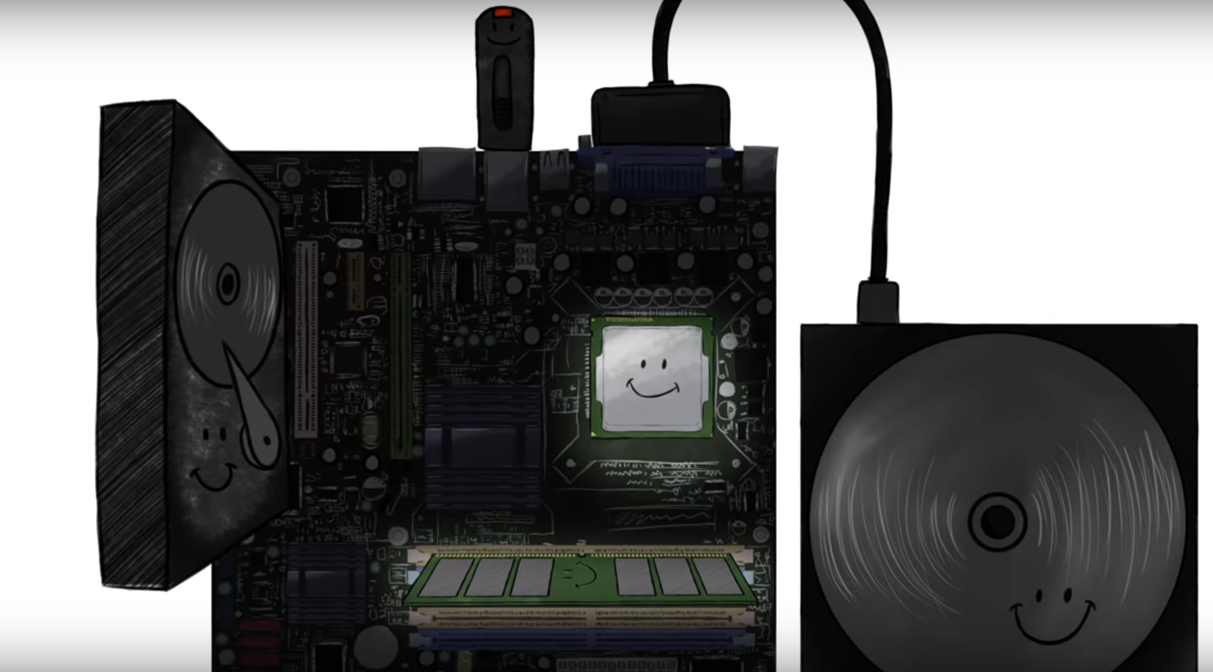
Memory in the computer

Slide 5
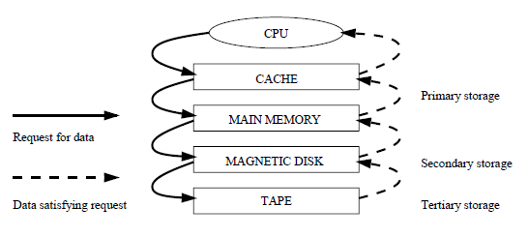
THE MEMORY HIERARCHY
Primary storage is:
  Volatile
  Prohibitively expensive
Secondary and Tertiary storage are:
  Nonvolatile
  Cheaper

Slide 6
The solution
Build database systems that can retrieve data from lower levels of the memory hierarchy into main memory as needed for processing.

Slide 7
Disk arrays

Slide 8
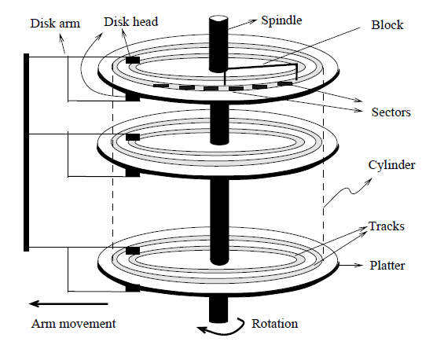
Magnetic disks
Data is stored on disk in units called disk blocks.
A disk block is a contiguous sequence of bytes and is the unit in which data is written to a disk and read from a disk.
Blocks are arranged in concentric rings called tracks, on one or more platters.
The set of all tracks with the same diameter is called a cylinder.
Each track is divided into arcs called sectors.

Slide 9
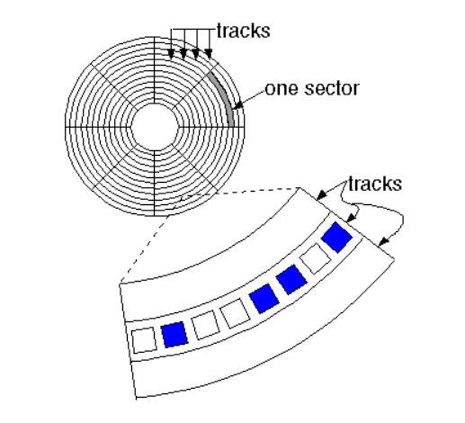
Magnetic disks
The data bits are recorded as tiny magnetic spots on the tracks.
Data must be in memory for the DBMS to operate on it.
The unit for data transfer between disk and main memory is a block.
If a single item on a block is needed, the entire block is transferred.

Slide 10
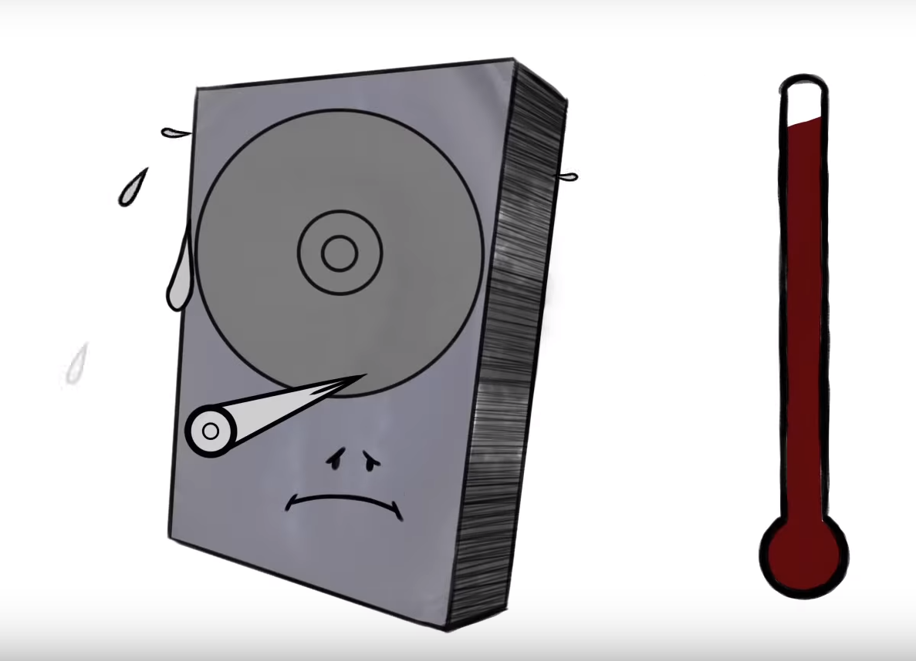
Why disk arrays?
Disks are potential bottlenecks for system performance and storage system reliability.
  Disk performance is not improving as efficiently as the microprocessor performance.
  Since disks contain mechanical elements, they have much higher failure rates.
  The mean-time-to-failure MTTF of a single disk is 50 000 hours (about 5.7 years).
  The heat generated from a device and its environment will eventually demagnetize the drives.

Slide 11
Disk arrays
A disk array is an arrangement of several disks.
  Increases performance through data striping.
  Improves reliability through redundancy.
Data striping distributes data over several disks to give the impression of having a single large, very fast disk.
Redundancy means that instead of having a single copy of the data, redundant information is maintained and carefully organized so that in case of a disk failure, it can be used to reconstruct the contents of the failed disk.
Disk arrays that implement a combination of data striping and redundancy are called redundant arrays of independent disks - RAID.

Slide 12
raid
The disk array is partitioned into reliability groups.
  Set of data disks.
  Set of check disks.
Check disks store parity information.
Reliability group
Data Disks
Check Disk
1001101
0101000
1100101
0101000
1001101
1100101
1100101
1001101
0101000
Even
or
Odd
1_ _ _ _ _
_ _ _ _ _ _ _ _ _ _ _ _
1010001
1001101
0101000
0001100
1001101
0101000
0110010
1001101
0101000

Slide 13

Disk arrays

Slide 14

Disk arrays – data striping
Data is segmented into equal-size partitions that are distributed over multiple disks.
The size of a partition is called the striping unit (can be bit or a disk block).
The partitions are usually distributed using a round robin algorithm: If the disk array consists of D disks, then partition i is written onto disk i mod D.

Slide 15
Disk arrays – data striping
I/O requests involve all disks in the array
Striping unit of a bit
The average response time for each
individual request is similar to that of a single
disk
Each I/O request involves transfer of at least 12 blocks
Data block with 2 bytes
2 bytes = 16 bits
Blocks are read in parallel
Bit 1
Bit 2
Bit 3
Bit 4
Bit 5
Bit 6
Bit 13
Bit 14
Bit 15
Bit 16
Data disk 1
Data disk 2
Data disk 3
Data disk 4
Data disk 5
Data disk 6
Bit 7
Bit 8
Bit 9
Bit 10
Bit 11
Bit 12
Data disk 7
Data disk 8
Data disk 9
Data disk 10
Data disk 11
Data disk 12

Slide 16
Disk arrays – data striping
One disk in the array can process one I/O request of the size of a disk block
Striping unit of a disk block
Data block with 10 bytes
The average response time of an I/O request is reduced.
Many I/O requests, where requested blocks
reside on different disks, are processed in
parallel
Disk block contains 5 bytes
Block 1
Block 2
Data disk 1
Data disk 2
Data disk 3
Data disk 4
Data disk 5
Data disk 6
Data disk 7
Data disk 8
Data disk 9
Data disk 10
Data disk 11
Data disk 12

Slide 17
Disk arrays – levels of redundancy
0. Nonredundant – no redundant information is maintained.
Mirrored – two identical copies of the data on two different disks are maintained.
Striping and Mirroring - data striping increases the maximum bandwidth available.
Error-Correcting Codes – striping at the bit level, good for workloads with many large requests since for each request the aggregated bandwidth of all data disks is used.
Bit-Interleaved Parity – striping unit of a bit and a single check disk with parity information.
Block-Interleaved Parity – striping unit of a disk block and a single check disk.
Block-Interleaved Distributed Parity – distributing the parity block uniformly over all disks.
P+Q Redundancy – recovers from up to two simultaneous disk failures, requires (conceptually) two check disks for four data disks.

Slide 18
Disk arrays – levels of redundancy
Redundancy Level | Data Disks | Check Disks | Space Utilization
0. Nonredundant | 4 | 0 | 100%
1. Mirrored |  | 4 | 50%
Striping and Mirroring |  | 4 | 50%
2. Error-Correcting Codes |  | 3 | 57%
3. Bit-Interleaved Parity |  | 1 | 80%
4. Block-Interleaved Parity |  | 1 | 80%
5. Block-Interleaved Distributed Parity |  | 1 | 80%
6. P+Q Redundancy |  | 2 | 66%

Slide 19
The disk space manager

Slide 20
Disk space manager
The disk space manager supports the concept of a page as a unit of data.
  The size of a page is chosen to be the size of a disk block.
  Pages are stored as disk blocks.
  Reading or writing a page can be done in one disk I/O.
Provides commands to allocate or deallocate a page and read or write a page.
  Provides the capability of allocating a sequence of pages as a contiguous sequence of blocks to hold data that is frequently accessed in sequential order.
Keeps track of which pages are on which disk block.
Keeps track of free blocks.
Allows higher levels of the software to think of the data as a collection of pages.

Slide 21
The buffer manager

Slide 22
buffer manager
All page requests are centrally processed by the buffer manager.
The buffer manager transfers pages between the disk and a special area of main memory called the buffer pool, which is divided into page-sized chunks called frames.
For each page in the buffer pool, the buffer manager maintains:
  a pin count, which indicates the number of users of the current page
  a dirty flag, which indicates whether the page has been modified.
A requested page is kept in the buffer pool until it is released (unpinned) by all users.
A page is written back to disk when the frame containing it is chosen for replacement.

Slide 23
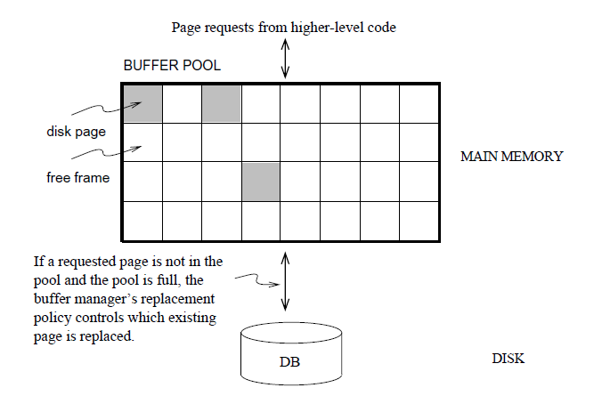
Buffer manager
Checks the buffer pool to see if some frame contains the requested page, and if so increments the pin count of that frame. If the page is not in the pool, the buffer manager brings it in as follows:
  (a) Chooses a frame for replacement, using the replacement policy, and increments its pin count.
  (b) If the dirty bit for the replacement frame is on, writes the page it contains to disk (that is, the disk copy of the page is overwritten with the contents of the frame).
  (c) Reads the requested page into the replacement frame.
2. Returns the (main memory) address of the frame containing the requested page to the requestor.

Slide 24
Files and indexes

Slide 25
Files and indexes
Database pages are organized into files, and higher-level DBMS code views the data as a collection of records.
The simplest file structure is a heap file, which is an unordered collection of records.
  Heap files are either organized as a linked list of data pages or as a list of directory pages that refer to the actual pages with data.
Indexes are auxiliary structures that support efficient retrieval of records based on the values of a search key.

